Slide 1
L. 12. Methods of gene expression

Slide 2
PURIFICATION OF MESSENGER RNA USING OLIGO DTCOLUMNS
Break open
cells in the
presence of
RNAse
Inhibitors
Total cellular RNA;
apply at room temperature to
anneal polyA tail to oligo(dT)
Oligo(dT)
attached to
cellulose
AAAA..
TTTT
Isolate RNA
65oC
polyA binds to
oligo(dT) on
column
TTTT
} non-polyA
RNA flows
through
AAAAA.
polyA mRNA elutes at
high temperature

Slide 3
Gene expression is a highly regulated mechanism that controls the function and adaptability of all living cells including prokaryotes and eukaryotes.
Several techniques exist for studying and quantifying gene expression and its regulation. Some of these techniques are old and well established while others are relatively new, multiplex techniques.
The field of gene expression analysis has undergone major advances in biomedical research.
Traditional methods focused on measuring the expression of one gene at a time and not in any particular biological context.
However, today, mRNA expression techniques have led to improvements in gene identification.

Slide 4
Cells in all living organisms are continually activating or deactivating
genes through gene expression, which contain the information required
for producing proteins through proteins synthesis. When a particular
protein is required by the cell, the gene coding for that protein is
activated.
The first stage in producing a protein involves the production
of an RNA copy of the gene's DNA sequence. This RNA copy is the
messenger RNA.
The amount of mRNA produced correlates with the amount of protein eventually synthesized and measuring the amount of a particular mRNA produced by a given cell or tissue is often easier than measuring the amount of the final protein. Levels in gene activation may vary between cancerogenic and healthy cells.

Slide 5
Techniques that are low- to mid-plex (Сплетение). Reporter gene
A gene contains two functional segments. One is a coding DNA sequence, which contains the instructions for making a protein.
The other is a DNA sequence called a promoter, which is linked to this coding region and regulates the gene’s transcription, either by activating or suppressing its expression.
A reporter gene assay is used to determine the regulatory potential of a DNA sequence that is unknown.
This involves a promoter sequence being linked to a detectable reporter gene such as luciferase, β-galactosidase or β-glucuronidase. Examples of methods used to determine the expressed reporter gene protein are fluorescence, absorbance and luminescence.

Slide 6
Northern blotting. Western blotting
This is a technique used to detect specific RNA molecules present within an RNA mixture. Northern blotting is employed in the analysis of an RNA sample from a cell type or tissue so as to determine the RNA expression of certain genes.
Western blotting is a technique for detecting specific protein molecules within a protein mixture. This mixture might include all the proteins that are associated with a certain cell type or tissue. The technique can help to determine a protein’s size, and how much of it is expressed.

Slide 7
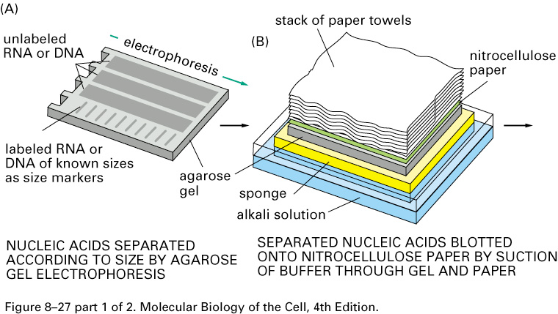
NORTHERN BLOT

Slide 8
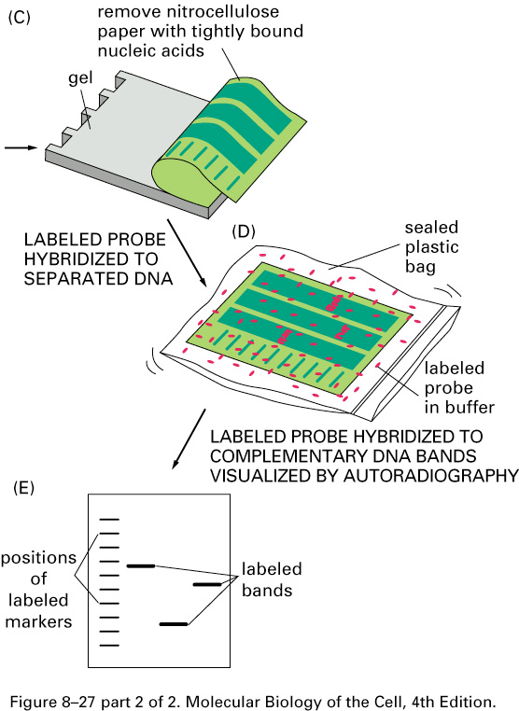
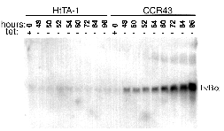
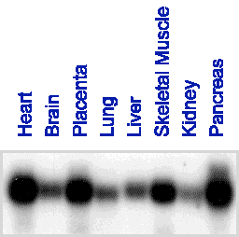

Slide 9
How can amounts of RNA be quantified?
The slide shows a virtual Northern with two lanes, one with RNA from control cells, the other with RNA from the experimental sample (eg drug treated cells). Let’s say that there is 10x the amount of signal in the experimental sample compared to the control sample for the target gene.
This could mean expression of the gene has increased 10-fold, or it could mean that there is 10x as much RNA in the experimental sample.
To check for this one usually does a so-called ‘loading control’ in which the blot is probed for expression of a gene which does not change (e.g. actin, GAPDH, cyclophilin, RPLP0 mRNAs; ribosomaL RNA).
In this case, let’s say that the loading control shows that there is twice as much RNA in the expt lane.
Thus the real change in the target gene is 10/2 =5 fold. We can express this in a
more general fashion:

Slide 10
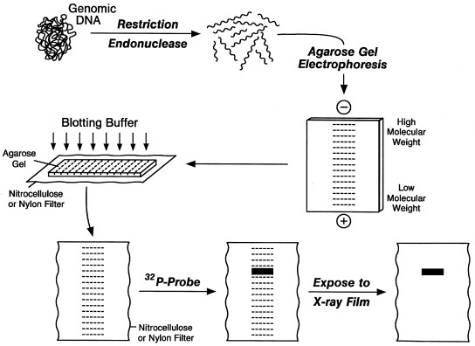
Northern blot

Slide 11
NORTHERN BLOT
1. mRNA isolation and purification
2. electrophorese on a gel
3. The gel is probed by hybridizing with a labeled clone for the gene under study.

Slide 12
Fluorescent in situ hybridization (FISH)
This is a cytogenetic technique that can be used to identify and locate specific gene sequences. FISH can be used to visualize copy number aberrations such as the deletion, translocation or amplification of chromosomes. The technique is used in prenatal diagnosis and also provides a useful tool in the diagnosis and predicted prognosis of various sarcomas. The technique is also used in dermatology to help evaluate atypical moles.

Slide 13
Methods for the Study of Gene Expression
Multiple Transcripts Simultaneously:
Single Transcripts:
● Northern blot
● RNAse protection assay
● Reverse Transcription (RT)-PCR
● Real-time PCR (qPCR)
● In-situ-hybridization
●
Dot-Blot analysis
● Differential Display, SAGE
● Subtractive hybridization (1996)
● DNA Microarrays (1999)
● NanoString
● Second generation Sequencing (NGS)

Slide 14
Reverse transcription polymerase chain reaction (RT-PCR)
This is the most sensitive technique available for detecting and quantifying mRNA. Using RT-PCR, extremely small sample sizes can be used in the quantification of mRNA and the technique can in fact do this using just a single cell.

Slide 15
MOLECULAR METHODS TOOL BOX
 | I. Analysis II | Overexpression III | Inhibition
Protein | Western Blot •Proteomics •immunohistochemisty •protein chimera | •(adding proteins to in vitro reactions) | •pharmacological inhibitors, •dominant-negative proteins, • protein depletion using antibodies
RNA | Electrophoresis •microinjection •Northern Blot •RNAse protection assays •Microarrays •RT-PCR •RNA in-situ | •(microinjection) | RNAi & •siRNA •Morpholinos
DNA (gene) | Reporter genes | •(microinjection) •Electroporation, •lipofection, •transgenics | Knock-out •Integrational mutagenesis •Classic genetics

Slide 16
DNA microarray
Also known of as biochip or DNA chip, a DNA microarray is a solid surface to which a collection of microscopic DNA spots are attached. The microarrays are used to determine expression levels across a large number of genes or to perform genotyping across different regions of a genome

Slide 17
RNA Seq
This refers to methods used to measure the sequence of RNA molecules. Examples include shotgun sequencing of cDNA molecules acquired from RNA through reverse transcription and technologies used to sequence RNA molecules from a biological sample so that the primary sequence and abundance of each RNA molecule can be determined.

Slide 18
Differential Display (DD)
Basic idea:
– Run two RNA (cDNA) samples side by
side on a gel
– Excise and sequence bands present in
one lane, but not the other
• The clever trick: (Умный трюк)
– Reduce the complexity of the samples by
making the cDNA with primers that will
prime only a subset of all transcripts

Slide 19
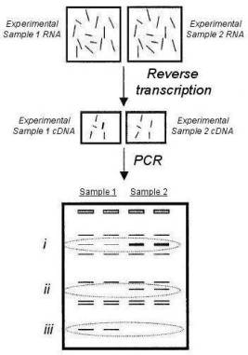
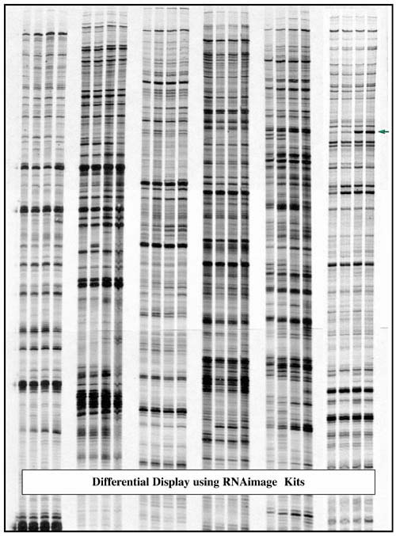

Slide 20
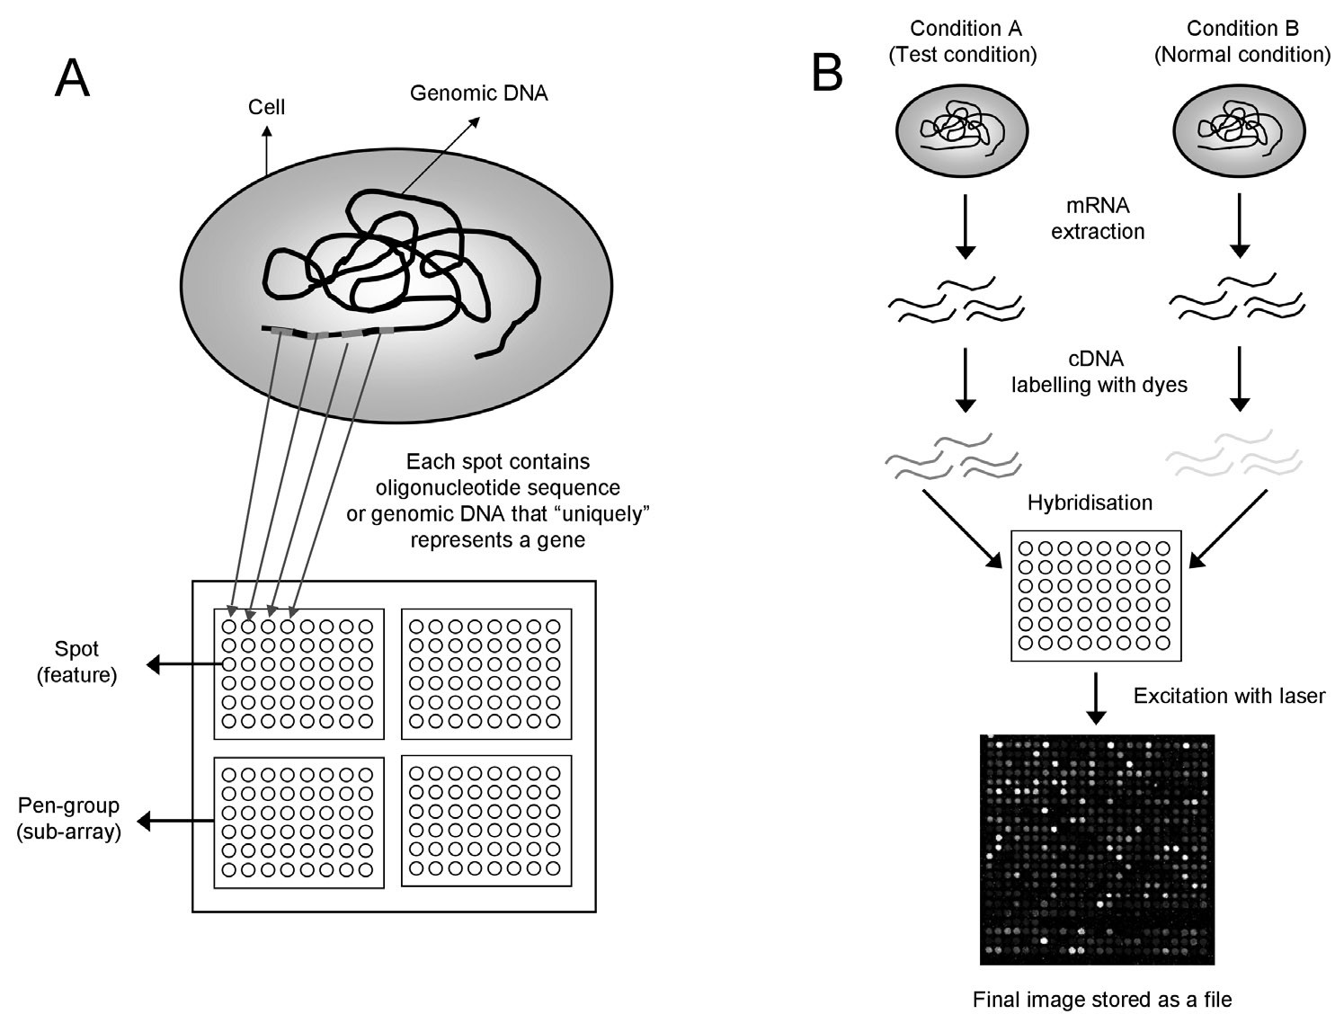
What are microarrays

Slide 21
Advantages and Disadvantages of microarray techniques
Advantages:
Disadvantages:
● Concurrent detection of thousands of genes
● Result is a global answer
● Experiments are fast and easy to perform
● The technique is cost effective
●
Expression differences are relativ
● Crosshybridization is possible
● Data has to be validated by other methods (eg. qPCR)
● Weak expressed genes may not be detected
● Changes in mRNA expression pattern may not effect protein abundance

